Slide 1
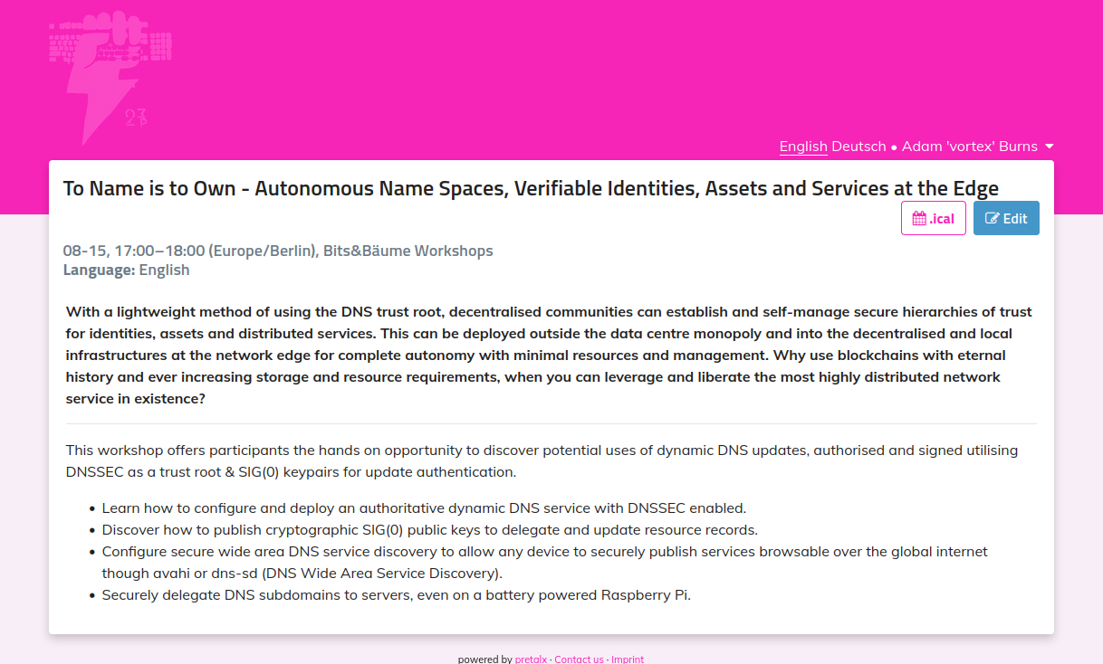

Slide 2

Workshop summary
Gentle Introduction
DNS and how it works (usually does)
DNS updates (DNS read/write capabilities)
Wide Area unicast DNS-SD (global scope)
DNSSEC process and details
Project sig0zonectl
Stitching all the above together
Github: https://github.com/adam-burns/sig0zonectl
Please clone and explore during workshop
Further ideas and hacking

Slide 3

Workshop motivations
Autonomy
minimise external dependencies.
minimise extractive proprietary external APIs
Offers an initial trust root through which others can grow.
Sustainability
minimal deployment footprint
(DNS is already around us & flows like water)
scale use as you and your community grow
Politics
growth of opportunity for local independent and community network service offerings
remove unnecessary extractive 3rd party services
remove unnecessary use of centralised data center infrastructures

Slide 4
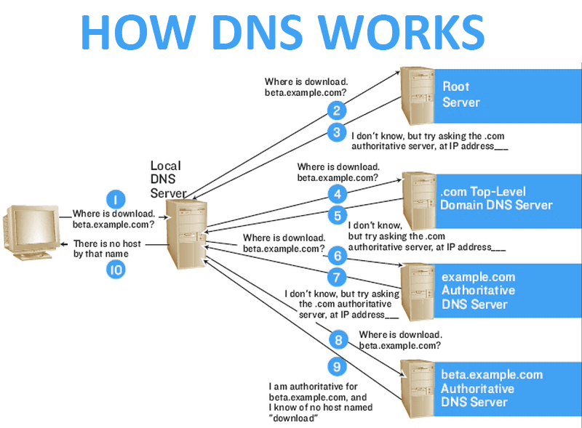
Basic DNS: talkin’ bout a resolution ...
DNS Server deployment types:
recursive caching resolver servers
(usually local, sometimes public, eg Google)
authoritative zone servers
(usually global)
DNS transaction type usually a read-only ‘query’
ask question (query)
get answer (resolution)
DNS serves answers to queries to resource record types, e.g. A records for IPv4, AAAA records for IPv6 & MX records for mail server address resolution.
nsupdate -T gives full list of DNS resource record types.
from https://techreader.com/files/2016/12/how-the-dns-system-works.png

Slide 5
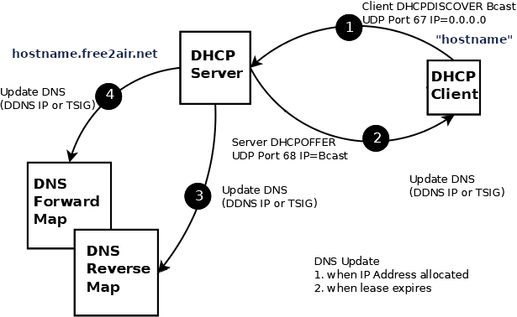
Basic DNS: dynamic DNS update
Dynamic DNS:
allows DNS records to be added, changed or deleted.
uses DNS transaction type ‘update’.
often deployed with DHCP servers for quick server name deployment for internal ‘trusted’ infrastructure.
uses a shared secret authentication (TSIG), which
  requires manual reconfiguration for new secrets.
  is not very secure for 3rd party authentication at scale.
Rant: The shortcomings of TSIG encouraged some public DNS service providers to implement non-interoperable REST APIs over HTTPS to provide non-standard “dynamic DNS-like” services to their customers.
butchered from https://www.zytrax.com/books/dns/ch9/dhcp-1.png

Slide 6
Example: Community Wireless Network
# selected example of DHCP TSIG auto-deployed resource records
# DNS A records under free2air.net domain
Arifs-iPhone A 93.97.42.65
Aude5-PC A 81.187.145.171
BLACKBERRY-3199 A 93.97.42.66
CMAC A 81.187.145.166
FRANCESCA A 93.97.42.65
Giless-iPhone A 93.97.42.66
grrs-iPhone-7 A 93.97.42.71
iDizz A 93.97.42.69
iPod A 81.187.145.163
iPod-4 A 81.187.145.166
james-iphone-2 A 93.97.42.66
JNR-iPhone A 93.97.42.71
Lejito-s-iPhone A 93.97.42.68
Livvys-iPhone A 93.97.42.65
minint-pv12anv A 93.97.42.67
Phone A 93.97.42.68
Riz A 93.97.42.66
robs-iPhone A 93.97.42.67
#
Hards-iPhone A 10.1.0.197
iPhone-2011-emb A 10.1.0.247
butchered from https://www.zytrax.com/books/dns/ch9/dhcp-1.png

Slide 7
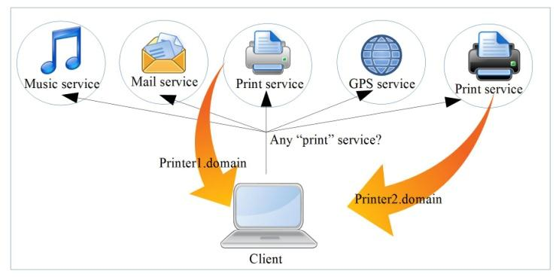
DNS Service Discovery (DNS-SD)
DNS-SD provides for 3 core functions within a DNS domain the use of DNS PTR, TXT & SRV resource records for:
service registration (service offering)
service enumeration (service browsing)
service use (service resolving/lookup)
DNS-SD offers these functions over two core transport mechanisms for two distinct scopes:
multicast DNS for local broadcast domains
(for .local addresses)
unicast DNS for global domains
(for all other TLD addresses)
Service Browsing example for print services
from https://www.researchgate.net/publication/279177017_Internet_of_Things_A_Survey_on_Enabling_Technologies_Protocols_and_Applications
$ORIGIN _dns-sd._udp.domain.
b PTR domain.
db PTR domain.
dr PTR domain.
lb PTR domain.
r PTR domain.
_services PTR _printer._tcp.domain.
$ORIGIN _printer._tcp.domain.
PTR Printer1.domain
PTR Printer2.domain

Slide 8
Example: Community Wireless DNS-SD
# small selection of DNS-SD browsable services
# and service instance examples
# under free2air.net domain
#
$ORIGIN _dns-sd._udp.free2air.net.
_services PTR _ftp._tcp.free2air.net.
PTR _ipp._tcp.free2air.net.
PTR _rfb._tcp.free2air.net.
PTR _ssh._tcp.free2air.net.
PTR _daap._tcp.free2air.net.
PTR _http._tcp.free2air.net.
PTR _printer._tcp.free2air.net.
PTR _sftp-ssh._tcp.free2air.net.
PTR _afpovertcp._tcp.free2air.net.
PTR _bittorrent._tcp.free2air.net.
PTR _pulse-sink._tcp.free2air.net.
PTR _workstation._tcp.free2air.net.
PTR _pulse-server._tcp.free2air.net.
PTR _pulse-source._tcp.free2air.net.
$ORIGIN _tcp.free2air.net.
_workstation PTR media\032iii._workstation
_ssh PTR media\032iii._ssh
_rfb PTR RemoteGuest._rfb
$ORIGIN _rfb._tcp.free2air.net.
RemoteGuest TXT "fullname=" "type=shared" "u=guest"
Service Browsing example for print services
from https://www.researchgate.net/publication/279177017_Internet_of_Things_A_Survey_on_Enabling_Technologies_Protocols_and_Applications

Slide 9
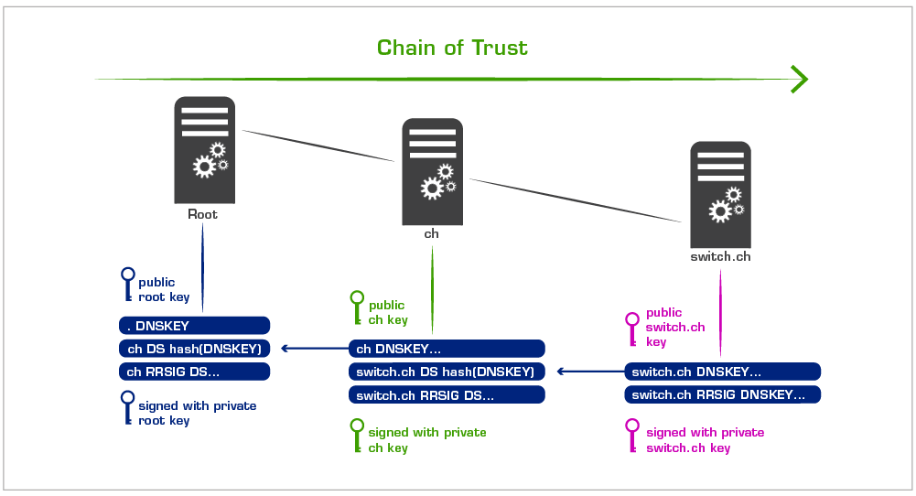
Basic DNSSEC: DNS Chain of Trust
DNS Security Extensions (DNSSEC) introduces a cryptographic chain of trust for integrity, with the DNS root key as the trust anchor.
The DNS root key signing ceremony is a regular event guided by an audited strong security process that brings together multiple independent stakeholders to update and sign the DNS root key.
from https://www.nic.ch/export/shared/.content/images/dnssec_chain_en.png

Slide 10
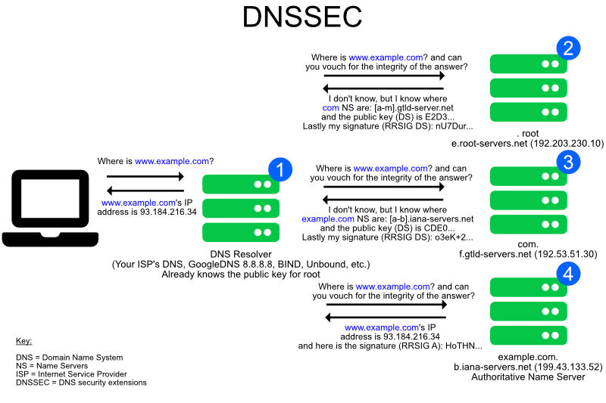
Basic DNSSEC: in practice
DNSSEC adds new DNS resource record types:
DNSKEY records for zone & key signing*.
DS records for hashes of child zone DNSKEYs
(linking chain of trust).
RRSIG records for signatures of individual resource records.
NSEC records for proof of non-existence of resource records within a signed zone.
Most major DNS server implementations (e.g. BIND9, Knot DNS) allow automated managed DNSSEC signing of even dynamic DNS zones(!)
* Early versions of DNSSEC used KEY records which is now only used for SIG(0) authentication.
from https://dnscrypt.info/_nuxt/img/DNS-DNSSEC.0de4990.png

Slide 11
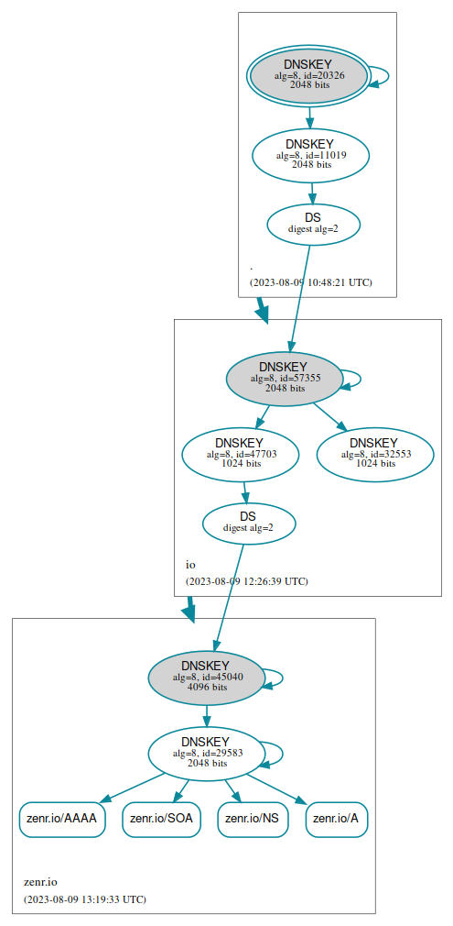
Example: Visualising
DNSSEC chains of trust
The website dnsviz.net offers an on-line service of the open source dnsviz toolkit to visualise details of DNSSEC chains of trust.
For a selected domain, it uses:
DNSKEY records to show zone key details.
DS records to show link details in the chain of trust.
RRSIG records & NSEC records to to show the set of signed resource record types within a signed zone.
Fun-with-DNS note: DNSSEC also supports IDN with punycode – for example, use dnsviz to visualise the trust chain of xn--dr8h.zembla.zenr.io.
Example visualisation of zenr.io trust chain from root

Slide 12
SIG(0) DNS Update Authentication
$ dig +noall +answer +multiline vortex.zenr.io KEY
vortex.zenr.io. 600 IN KEY 512 3 15 (
2MK3KZkUgYQVumU9bhy1KzIZ2FhFQZ8yLP2nFMJRCEQ=
); alg = ED25519 ; key id = 56161
SIG(0) is a modern standard authentication method that uses a public and private key pair to sign DNS(SEC) update requests.
The public key is published as a DNS KEY resource record.
The private key should kept secure with the host that generates the key pair and submits the DNS update request.
Using dig to get further information about the KEY zebla.zenr.io

Slide 13
SIG(0) Domain KEY Request
$ ZONE="zenr.io" NEW_SUBZONE="zembla" ./request_key
Generating key pair.
Kzembla.zenr.io.+015+55028
New SIG0 keypair for zembla.zenr.io generated in ./keystore
KEY request 'zembla._signal.zenr.io IN KEY 512 3 15 duQIg/NgFjwsE8ZKUuXJUG2/NNFs4o4byuwnekT062U=' added
$
Using the sig0zonectl tool request_key, zembla.zenr.io is a KEY domain requested from the DNS server authoratitive for zenr.io zone.
The public key request is published as a DNS KEY resource record.
The private key should kept secure with the host that generates the key pair and submits the DNS update request.
Using the sig0zonectl tool request_key to generate a domain KEY resource record
$ dig +noall +answer +multiline zembla._signal.zenr.io KEY
zembla._signal.zenr.io. 60 IN KEY 512 3 15 (
duQIg/NgFjwsE8ZKUuXJUG2/NNFs4o4byuwnekT062U=
); alg = ED25519 ; key id = 23799
Using dig to get further information about the KEY zebla.zenr.io

Slide 14
SIG(0) Domain KEY Acceptance
$ ZONE="zenr.io" ./process_requests
LIST of KEY REQUESTS
_signal.zenr.io. PTR zembla._signal.zenr.io.
PROCESSING KEY REQUESTS
KEY 'zembla.zenr.io' submitted to add under zone 'zenr.io' with '[key id = 23799]', IDN 'zembla.zenr.io'.
With access to the zenr.io private KEY, the sig0zonectl tool process_requests grants subdomain KEY additions on a “first come, first served” (FCFS) policy basis.
If the subzone has no existing records at all, the KEY record is added and SIG(0) update access is granted for the KEY domain and all subdomains.
If any DNS resource record already exists, then the addition request made for publishing the KEY is denied.
Using the sig0zonectl tool process_requests to publish new KEY zembla.zenr.io
$ ZONE="zenr.io" ./process_requests
LIST of KEY REQUESTS
_signal.zenr.io. PTR vortex._signal.zenr.io.
PROCESSING KEY REQUESTS
KEY 'vortex.zenr.io' IS NOT submitted to add under zone 'zenr.io', as DNS resource records already exist.
Using The sig0zonectl tool process_requests denying KEY domain request zembla.zenr.io

Slide 15
DNS-SD domain configuration
$ ZONE="zenr.io" NEW_SUBZONE="zembla" ./dnssd-domain
$
DNS-SD offers standard DNS PTR resources to ease browsing & registering services within a domain.
For any particular domain, DNS_SD aware software query these PTR resource records underneath _dns-sd._udp to determine default domain hierarchies for service browsing and registration.
Using the sig0zonectl tool dnssd-domain to establish DNS-SD browsing & registration
PTR resource records for a domaon
$ORIGIN _dns-sd._udp.zembla.zenr.io.
b PTR zembla.zenr.io.
lb PTR zembla.zenr.io.
db PTR zembla.zenr.io.
r PTR zembla.zenr.io.
dr PTR zembla.zenr.io.
Listing of zone PTR updates under zembla.zenr.io after above command

Slide 16
DNS-SD service instance registration
$ DNSSD_SERVICES="_ssh._tcp _http._tcp _ftp._tcp” \
ZONE="zenr.io" NEW_SUBZONE="zembla" ./dnssd-domain
$
The DNS-SD standard offers a service instance set of DNS resource records with enough information to browse service types and enumerate service instance access details.
Each service type can be browsed & enumerated, DNS_SD allows further DNS resource record types such as PTR, SRV and TXT resource records underneath the service type subdomain (eg _http._tcp)to determine sufficient information to access the resource, including IP address & port, together with any service specific details.
The sig0zonectl dnssd-service script gives examples of how to register DNS-SD service types and instances for browsing & enumeration within a domain
$ avahi-browse -brat -d zembla.zenr.io
...
The dig or avahi-browse tool can be used to enumerate details of all service types and instances registered within a domain (long output not showm)
$ avahi-browse -tr _http._tcp -d zembla.zenr.io
+ n/a n/a zembla _http._tcp zembla.zenr.io
= n/a n/a zembla _http._tcp zembla.zenr.io
hostname = [zembla.zenr.io]
address = [2a01:4f8:c17:3dd5:8000::10]
port = [80]
txt = ["Hello_this_is_a__http._tcp_service_instance"]
The dig or avahi-browse tool can be used to enumerate details
of one of the example _http._tcp service instance registered above

Slide 17
DNS-SD service registration
$ ZONE="zenr.io" ./process_requests
LIST of KEY REQUESTS
_signal.zenr.io. PTR zembla._signal.zenr.io.
PROCESSING KEY REQUESTS
KEY 'zembla.zenr.io' submitted to add under zone 'zenr.io' with '[key id = 23799]', IDN 'zembla.zenr.io'.
With access to the zenr.io private KEY, the sig0zonectl tool process_requests grants subdomain KEY additions on a “first come, first served” (FCFS) policy basis.
If the subzone has no existing records at all, the KEY record is added and SIG(0) update access is granted for the KEY domain and all subdomains.
If any DNS resource record already exists, then the addition request made for publishing the KEY is denied.
Using the sig0zonectl tool process_requests to publish new KEY zembla.zenr.io
$ ZONE="zenr.io" ./process_requests
LIST of KEY REQUESTS
_signal.zenr.io. PTR vortex._signal.zenr.io.
PROCESSING KEY REQUESTS
KEY 'vortex.zenr.io' IS NOT submitted to add under zone 'zenr.io', as DNS resource records already exist.
Using The sig0zonectl tool process_requests denying KEY domain request zembla.zenr.io

Slide 18

Future Work @ Workshop, Camp & beyond
Further hacks in order of difficulty:
Simple DynIP style tool for IPv4 & IPv6 address updates (at camp?)
Find my Phone style tool updating DNS LOC resource records for any named resource – not everyone’s gear lives in a data centre (at camp)
ansible script and/or docker-compose config to assist with zone on-device DNS zone delegation (WIP – still a manual configuration process).
DANE browser implementation*
Federated W3C DID identitity & verifiable credentials name spaces
YOUR IDEAS HERE
* Ask me how angry I am about Mozilla and Google’s 15 year refusal to implement DANE because it benefits them not to.

